Slide 1
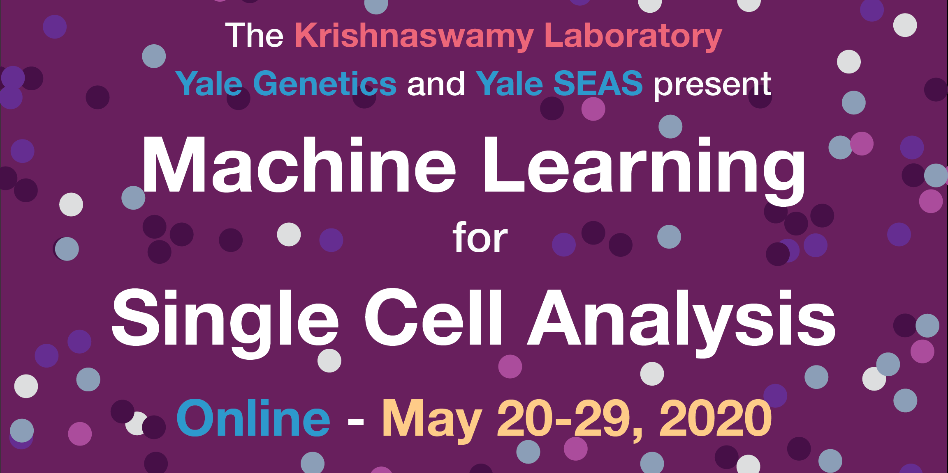

Slide 2
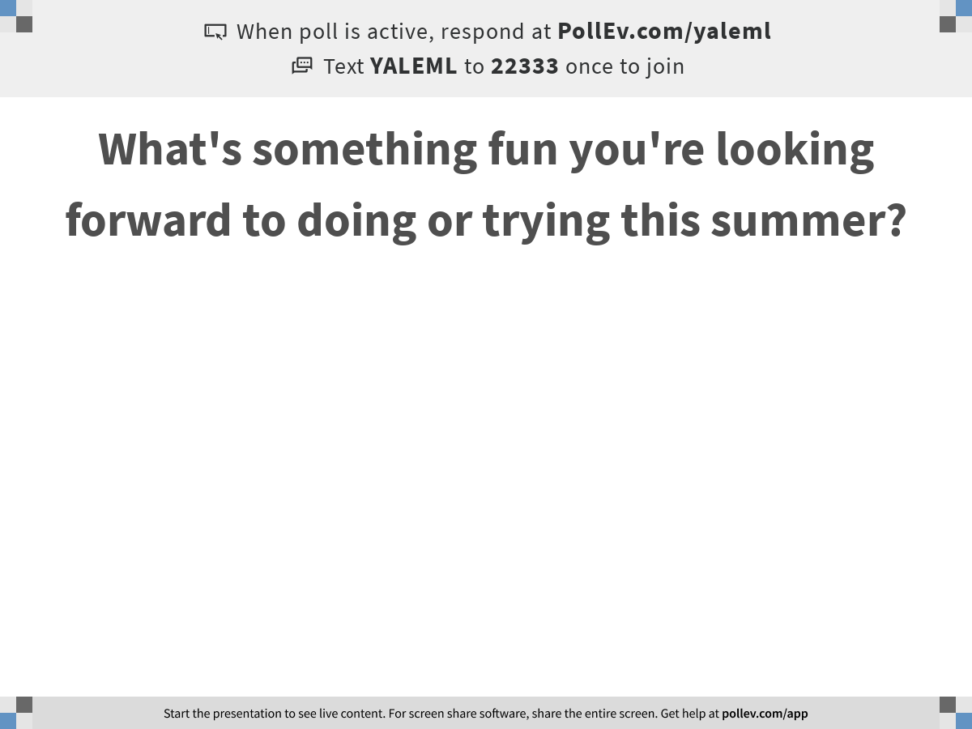
Notes:
What's something fun you're looking forward to doing or trying this summer?
https://www.polleverywhere.com/free_text_polls/OO0KsZ91Xb5UrcMTPQWnw

Slide 3
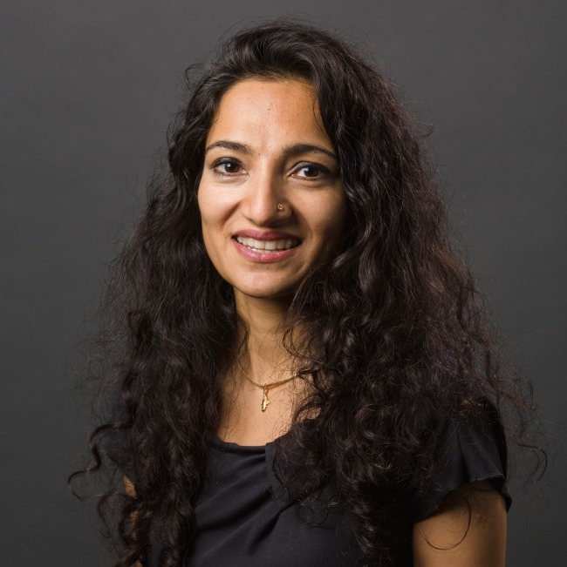
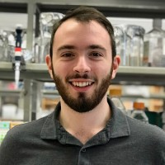
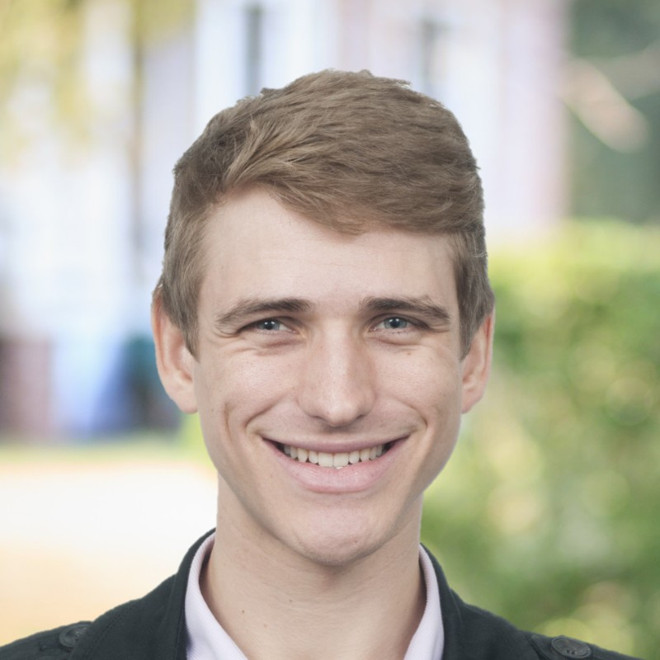
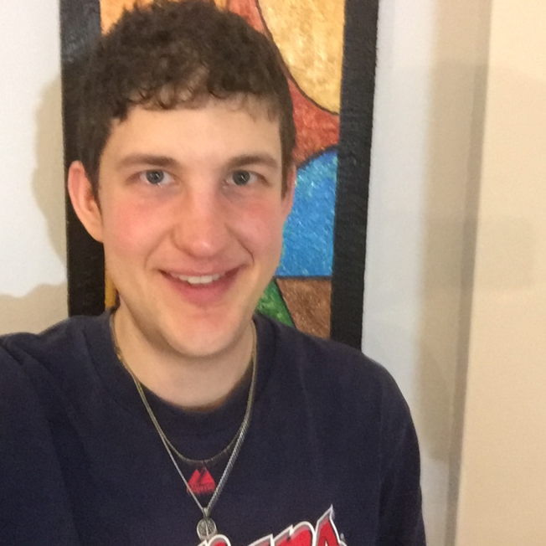
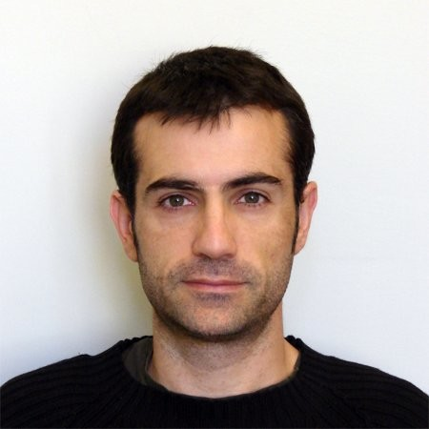

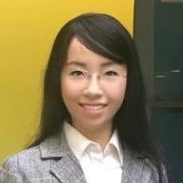
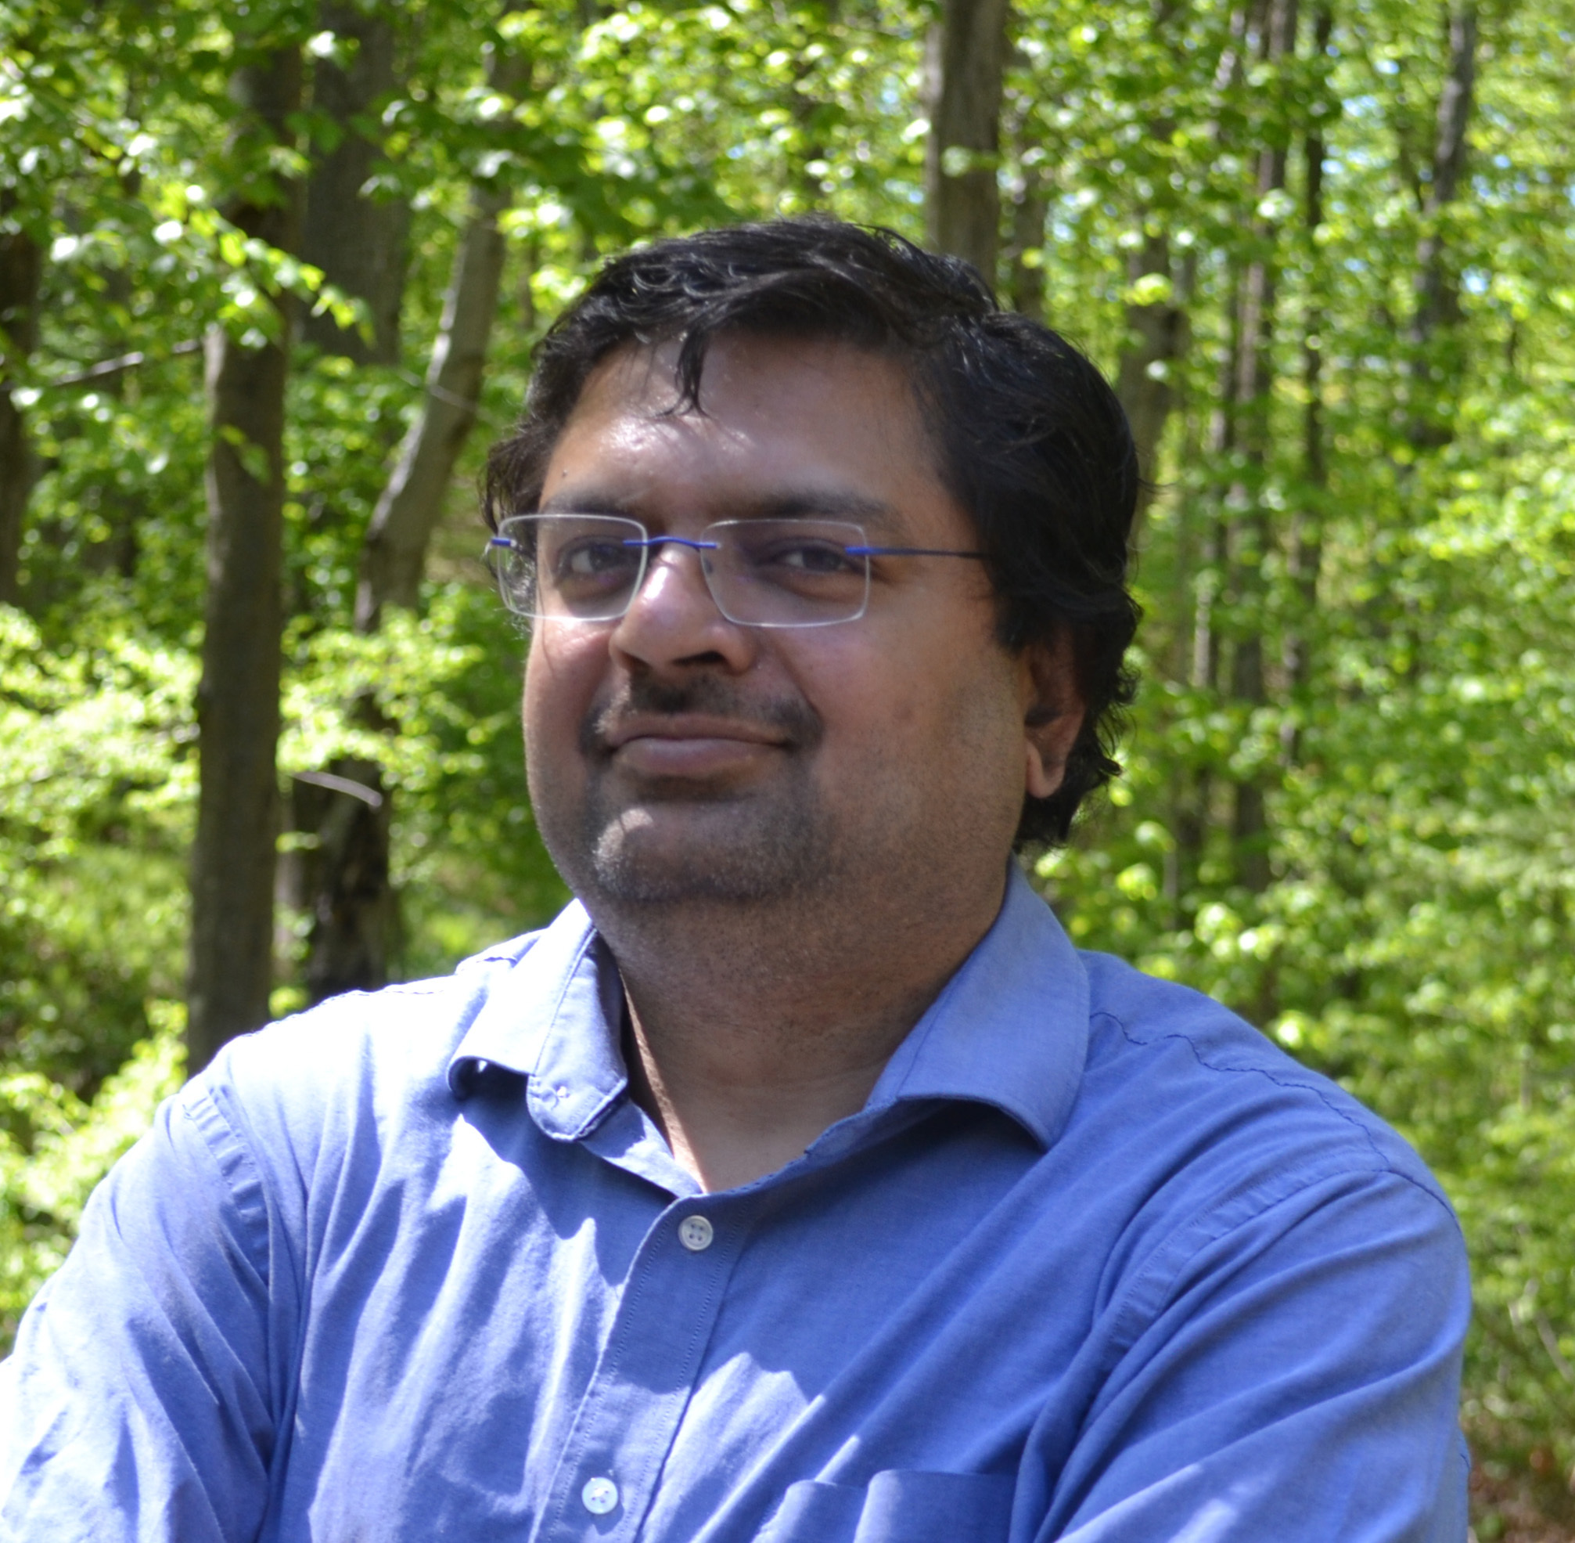
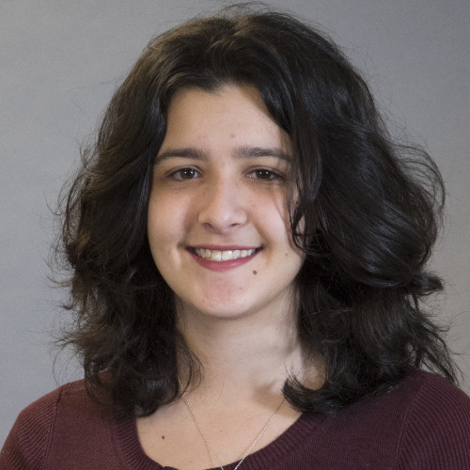

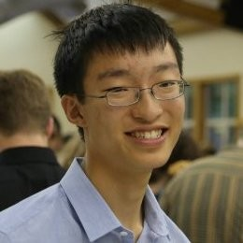


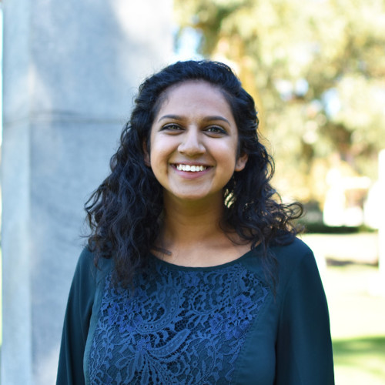
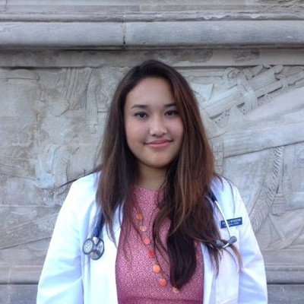

Smita Krishnaswamy, PhD
Daniel Burkhardt
Scott Gigante
Matthew Amodio
Francesc Lopez, PhD
Nur-Taz Rahman, PhD
Mamie Wang
Sameet Mehta, PhD
Edel Aron
Egbert Castro
Alexander Tong
Evan Cudone
Andrew Benz
Aarthi Venkat
Danielle Miyagishima
Wes Lewis

Slide 4
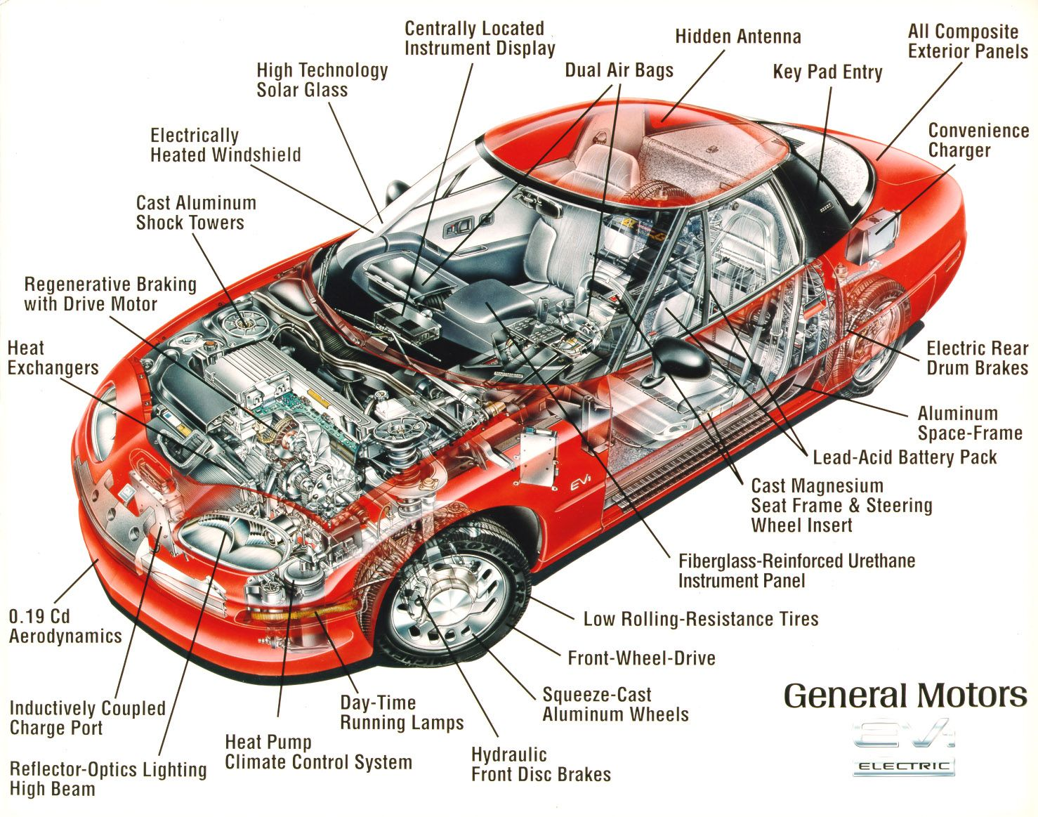

Slide 5

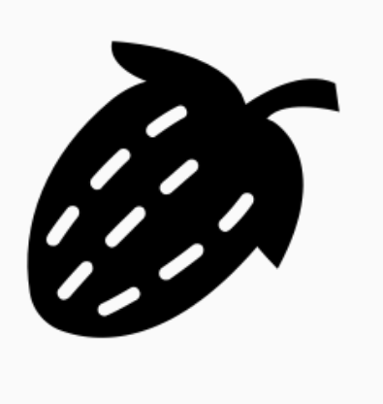



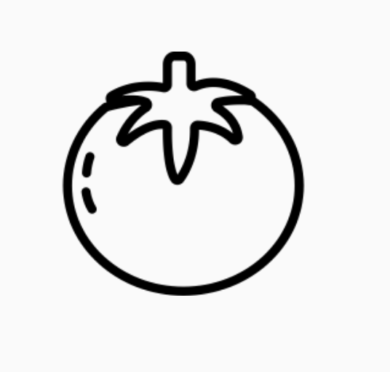

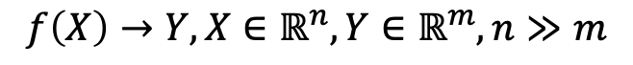
Two kinds of machine learning
Supervised learning
Have a bunch of labelled data, want to label new data
Learn a function $f\left(X\right)→Y$ where all values of $Y$ are known for some samples of $X$
Unsupervised learning
Have a bunch of unlabeled data, want to organize it
Learn an embedding
Lower dimensional, easier to interpret (e.g. as clusters)
$$f\left(X\right)→Y, X∈ℝ^{n},Y∈ℝ^{m}, n≫m$$
Supervised Learning Model
Unsupervised Learning Model
Noun project
Notes:
Carry the change to the figures

Slide 6
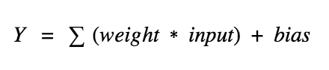
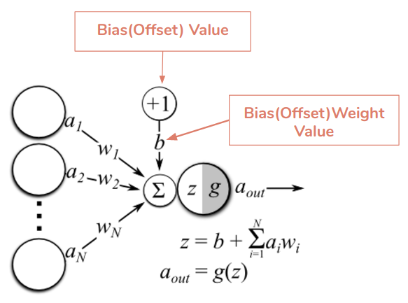
The output of a neuron is a sum of (weights * input) + bias
https://docs.paperspace.com/machine-learning/wiki/weights-and-biases

Slide 7
How to train your network
Training the network
Running the network
Randomly initialize all weights and biases
Run the network on a set of training data (batch)
Compare the output of the network to the expected output for the input using the cost function
Calculate the gradient of the cost function
Update the weights and biases according to the gradient using backpropagation
Repeat steps 2-5 until convergence
Compare results to the validation set to evaluate the performance of the network
If performance on validation set is poor due to underfitting or overfitting, reconfigure the network hyperparameters (e.g. # nodes, # layers, activation function, etc) and repeat 1 - 8
Run the network on your data
If your data is sufficiently different from the training data, you will need to retrain the network

Slide 8
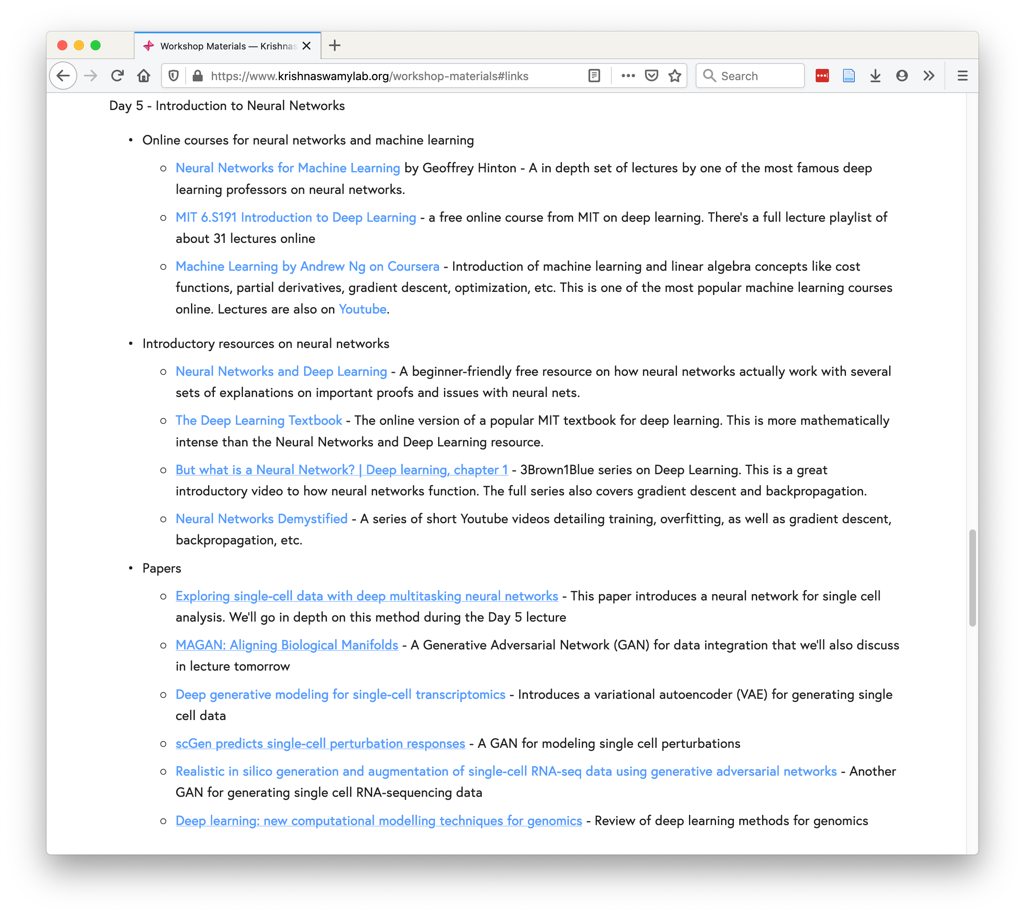
https://www.krishnaswamylab.org/workshop-materials#links

Slide 9

https://bit.ly/YaleML_May_PostSurvey

Slide 10

Autoencoders, GANs, Conditional GANs, Cycle GANs in Single Cell Analysis
Notes:
TA introduction
Talk about not teaching code (not a programming workshop)

Slide 11
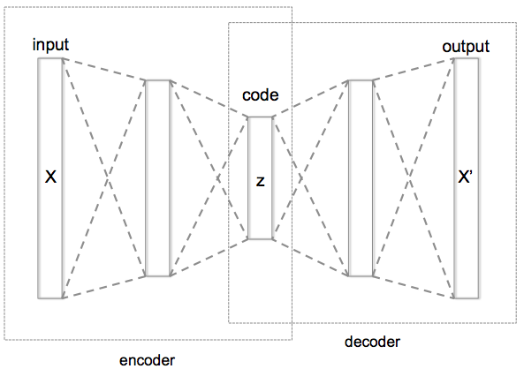
Autoencoder
Informational Bottleneck
[Hinton, Salakhutdinov, Science 2006]
Notes:
Here is an example of an autoencoder. The autoencoder tries to reconstruct its input, after passing it through the layers of the network.
Notice that there is an informational bottleneck here that we’ll talk about in a second.

Slide 12
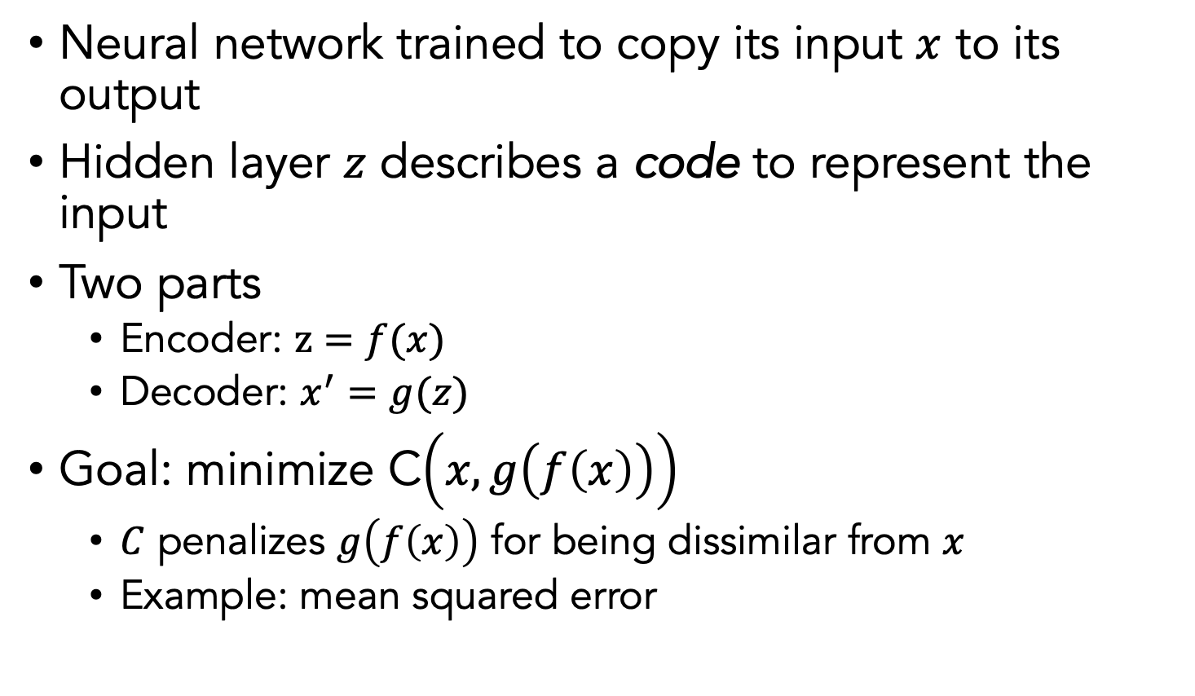
Autoencoder (AE)
Neural network trained to copy its input $x$ to its output
Hidden layer $z$ describes a code to represent the input
Two parts
Encoder: $z=f(x)$
Decoder: $x^{′}=g(z)$
Goal: minimize C$\left(x,g\left(f\left(x\right)\right)\right)$
$C$ penalizes $g\left(f\left(x\right)\right)$ for being dissimilar from $x$
Example: mean squared error
Notes:
Autoencoders are special types of neural networks that have been used to do unsupervised and semi-supervised settings
Recirculation compares activations of the network on the original input to the activations on the reconstructed input (considered more biologically plausible)

Slide 13
Autoencoders for Single-Cell Analysis
Autoencoders can do most of the single cell tasks that we have talked about so far by construction!
Dimensionality reduction
Visualization
Data denoising
Batch correction
Clustering
(synthetic) Data generation

Slide 14

How?
Code is a dimensionality reduced embedding
Reconstructed
output is denoised
(reconstructed from
Reduced dimensions)
Remaining tasks need special regularizations

Slide 15
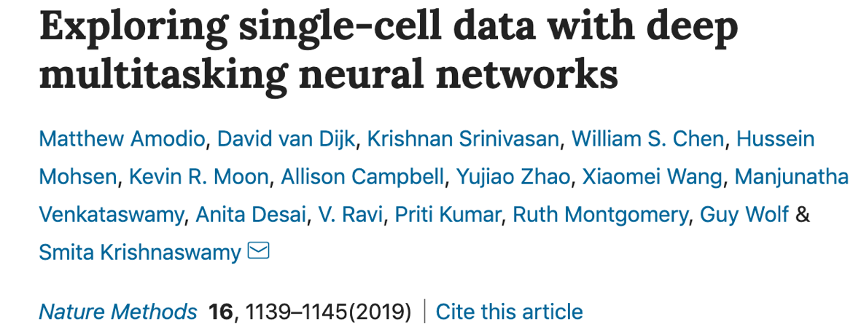
SAUCIE

Slide 16
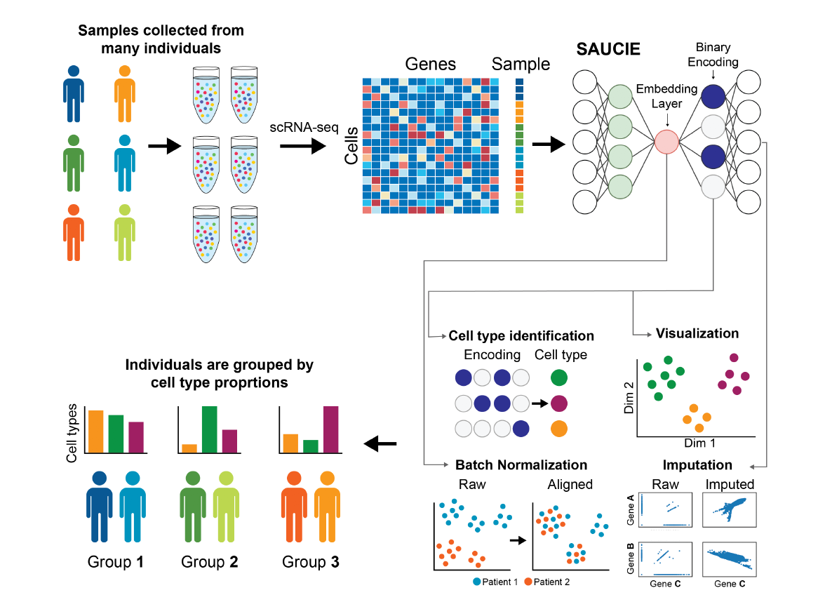

Slide 17
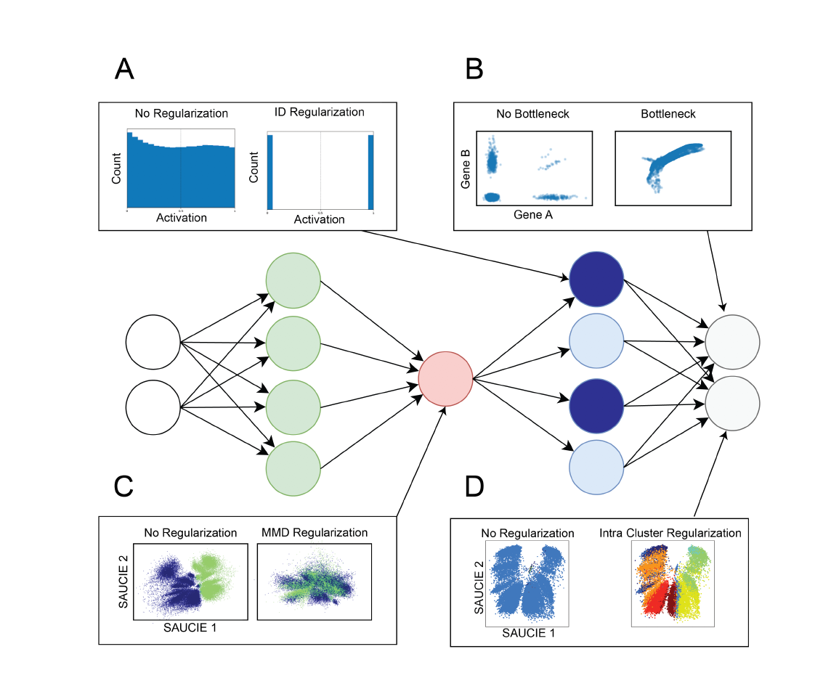

Slide 18
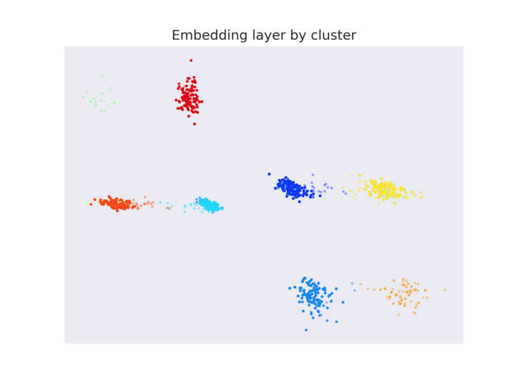
Representation for Clustering
We want: codes for subspaces
Binary activation, good spacing

Slide 19
Clustering: Information Dimension Regularization
High activation entropy
Low activation entropy
Penalty:

Slide 20
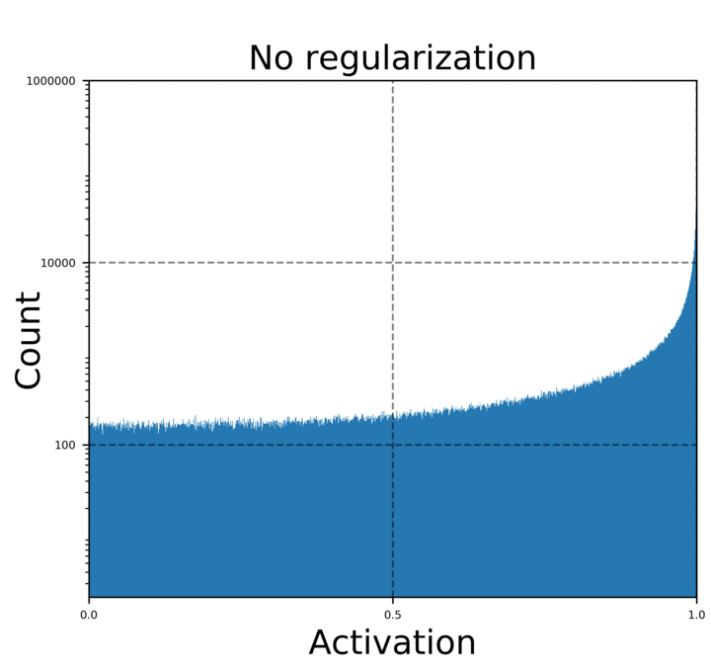
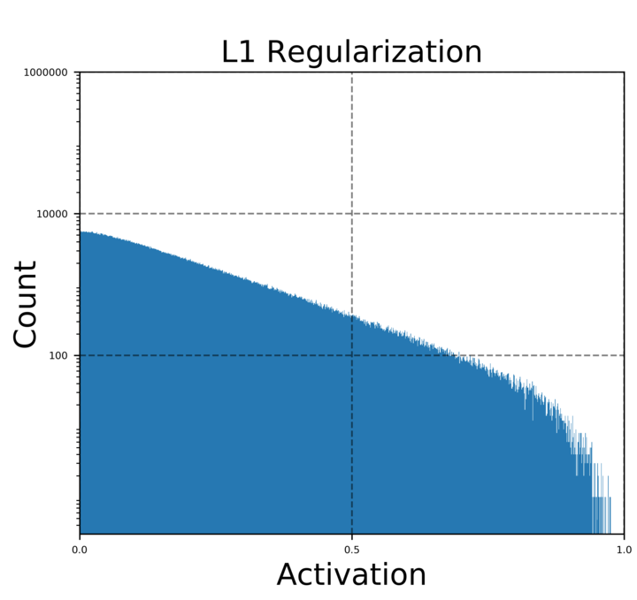
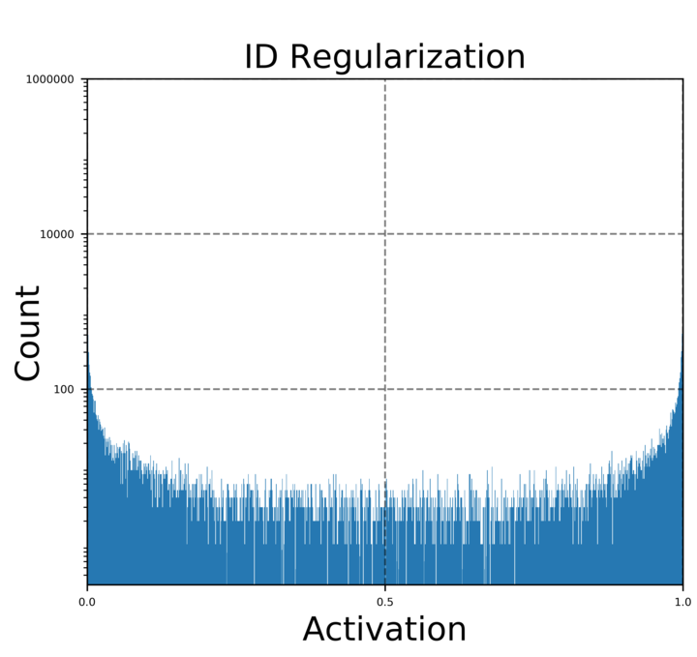
Information Dimension (ID) Regularization
No regularization
L1 regularization
ID regularization
ID regularization enforces a binary-like code

Slide 21
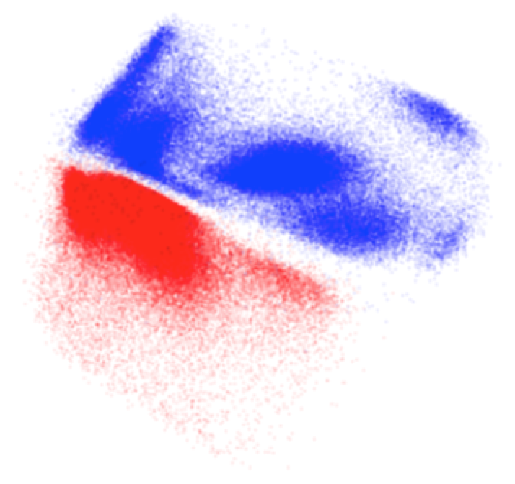
Batch Effects: Manifold Alignment
Patient 1
Patient 2

Slide 22
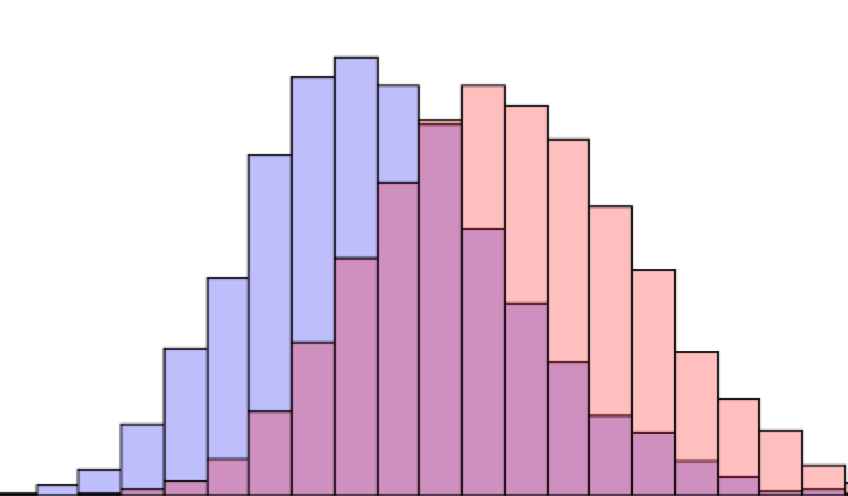
Mean Maximal Discrepancy
[Dziugaite, Roy, Ghahramani, UAI 2015]

Slide 23
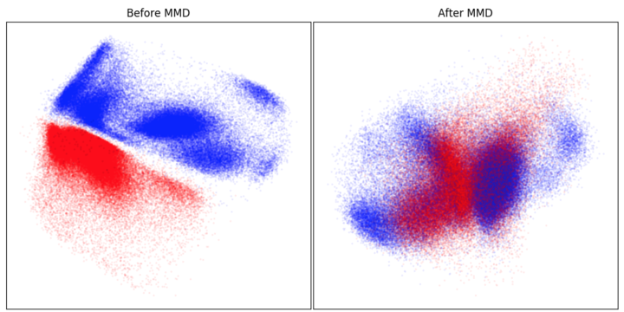

Slide 24
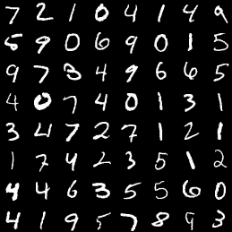
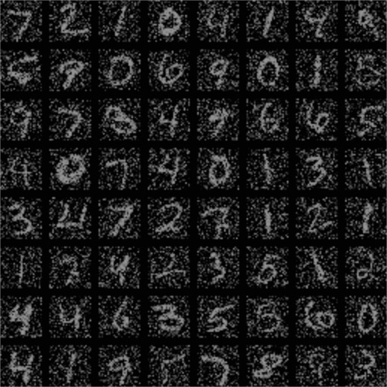
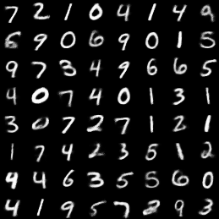
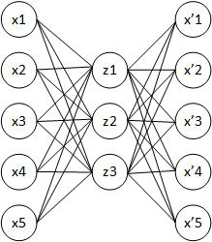
Reconstruction as Denoising
Original
Dropped-out data
Reconstructed
Notes:
The autoencoder naturally learns an imputed and denoised version of the data

Slide 25
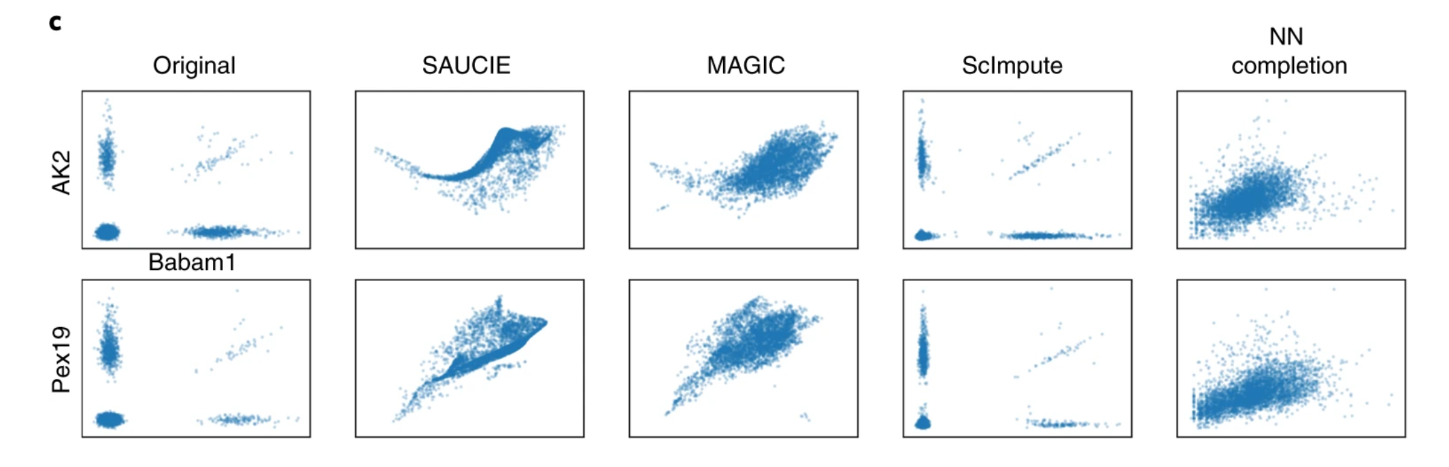
SAUCIE data denoising

Slide 26
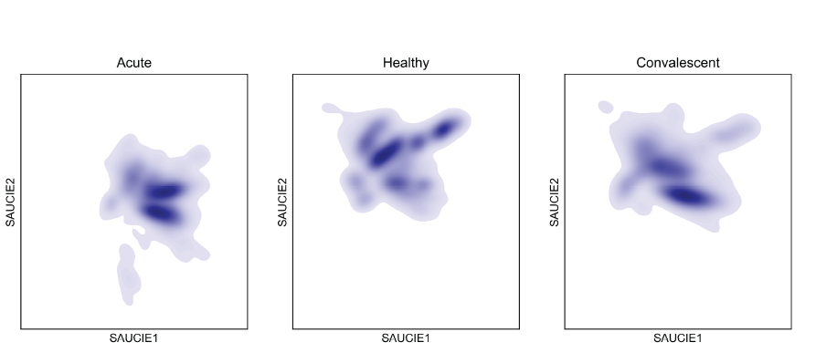
Cellular Manifolds of Dengue Patients

Slide 27
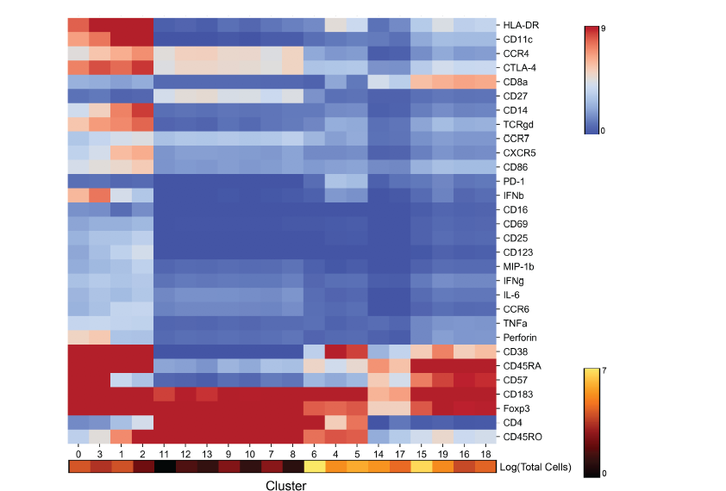
Cell Clusters: 180 Samples Combined

Slide 28
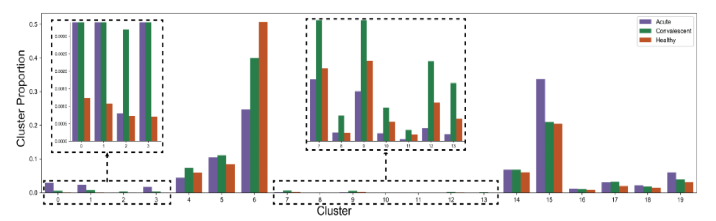
Patient Cluster Signatures
MMD distance can be derived between patient cluster proportions and embedded

Slide 29
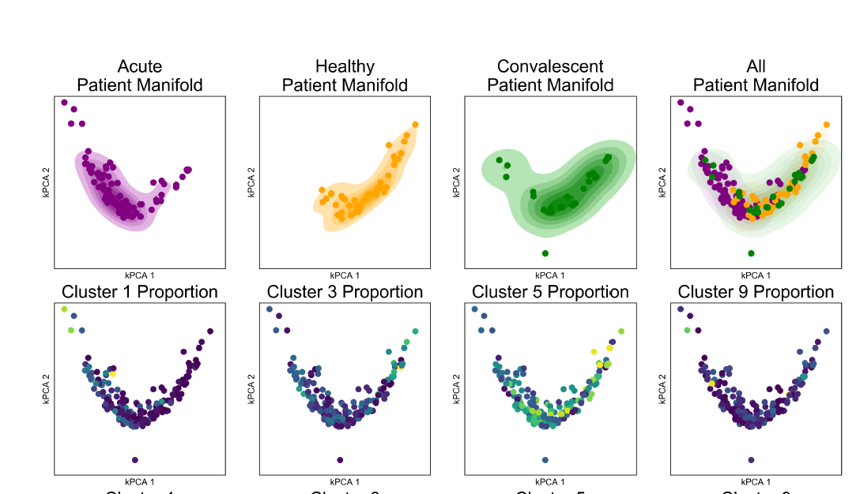
Patient manifolds show coherent organization

Slide 30
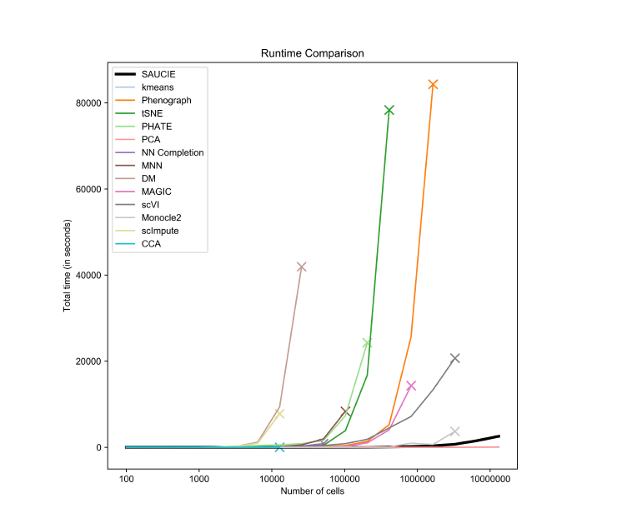

Slide 31
Generative Models

Slide 32
Generating samples from the data
Key use of neural networks is generating samples from data
One idea is to use the decoder without the encoder, sample from z and then have it decode to a datapoint
For single cell data, this would mean generating synthetic cells from a distribution

Slide 33
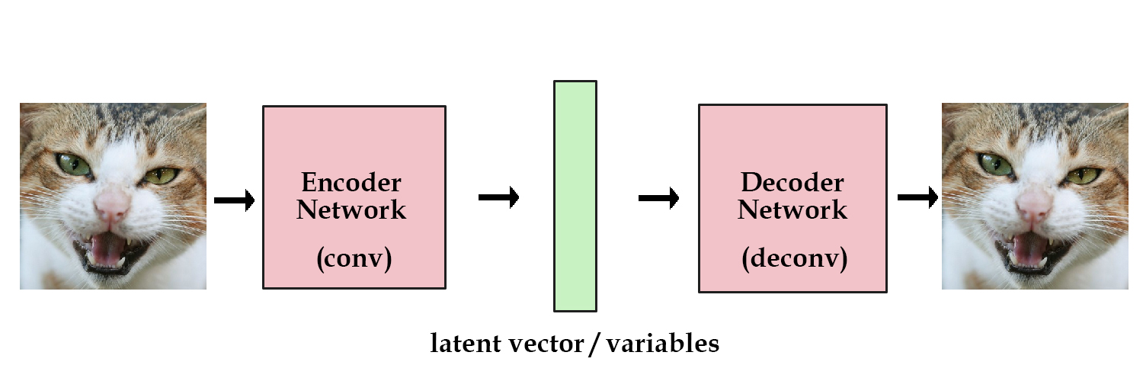
Variational Autoencoders (VAEs)
A type of neural network whose latent space is designed for sampling
Notes:
Shifting gears now to generative models
Ask them for any ideas?

Slide 34
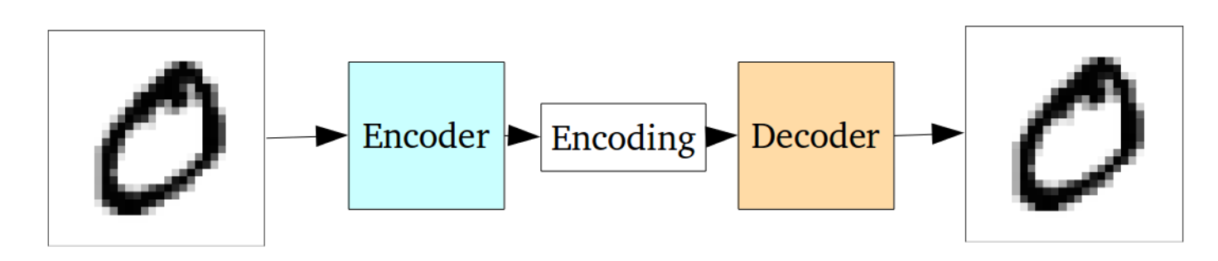
Why not autoencoders?
Optimized with Reconstruction Loss
Not explicitly penalized for Generative Purposes

Slide 35
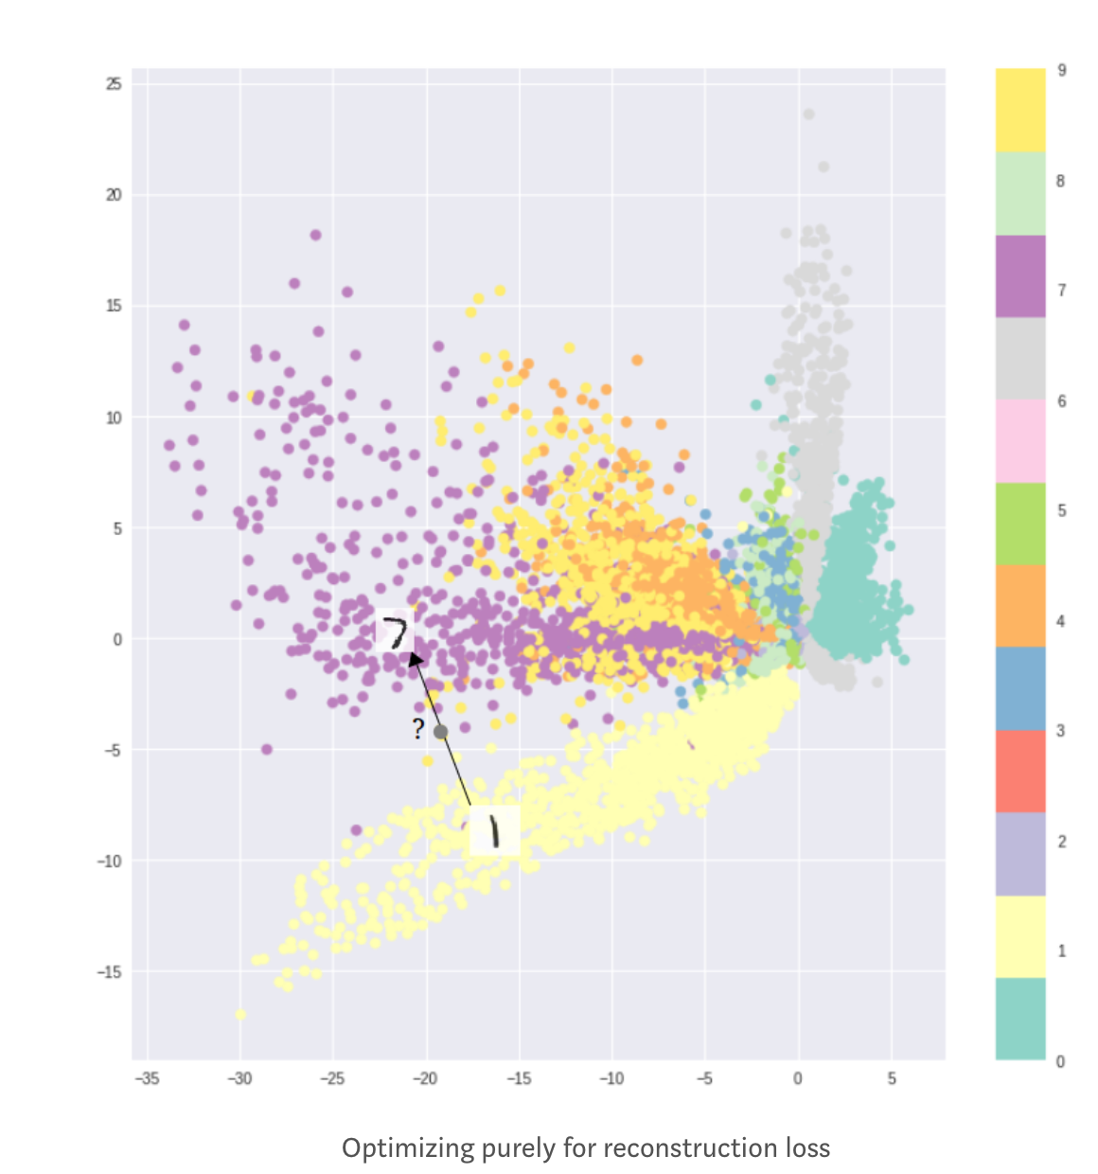
Latent Space Not Optimal for Generation
Formation of clusters helps decoding
Does not help generation
Latent space cannot be interpolated

Slide 36
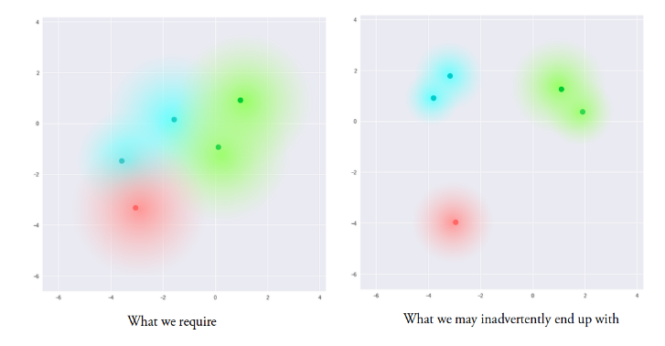
Encouraging continuous latent spaces
Solution: Penalize the Gaussian balls if they don’t overlap!

Slide 37
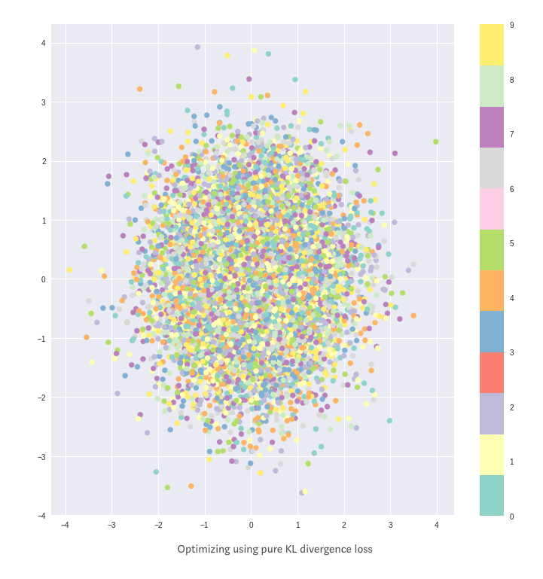
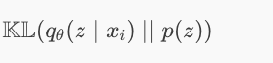
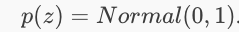
KL Divergence Penalty
Penalizing distributions
In the latent space from being
too far from a standard normal
Encourages every ball to be the same!

Slide 38



Loss Function of VAE
Reconstruction penalty encourages separation

Slide 39

KL+Reconstruction Loss

Slide 40

Variational Autoencoders (VAEs)
1st Epoch
9th Epoch
Original

Slide 41
VAEs in Single Cell Analysis.

Slide 42

scVI

Slide 43

sCVI
scVI uses latent space of VAE as a dimensionality reduced encoding fed to other algorithms

Slide 44

Probabilistic assumptions

Slide 45
Latent Space Arithmetic

Slide 46

scGEN

Slide 47
scGEN
Generates single cell response by doing latent space arithmetic
Perturbations are modelled as shifts

Slide 48


Generative Adversarial Networks
Noise
Something “like” training sample
Notes:
Visualization of samples from the model. The rightmost column shows the nearest training example of the column just to the left.

Slide 49

GAN functionality

Slide 50
GANs
Sample from an easy noise distribution (uniform, Gaussian)
One network learns a mapping G(Z)
Second network tries to distinguish true examples of X from “fake” samples G(Z)

Slide 51
2 Networks
Generator: takes random noise and transforms into sample from target distribution
Discriminator: discriminates between generated (“fake”) examples and real examples
The two networks play a “minimax game”
Indirect way of matching distributions

Slide 52


Only use generator after training
Generator network takes noise and transmutes them into samples from the data distribution
Implicitly learns high dimensional distributions

Slide 53

Generated Examples

Slide 54

GAN Loss function
Maximize discriminator value (1) on real samples
Maximize discriminators value (0) on generated samples
Generator wants the discriminator to do badly!

Slide 55
GAN Loss function
min_{G} max_{D}
This is the minimax game that the two adversaries play

Slide 56

Mode Collapse

Slide 57
GANs can be hard to train
Instability during training
Mode collapse
Take the whole batch as a training sample
Penalize for a property of the distribution (mean, variance)

Slide 58
Conditional GANs
GANs take noise z and turn it into our data x
Great! But what if we want to control it?
“It generated another image of a 3? I wanted a 7 this time!”
Conditional GANs:
If we have labels, we want to teach it to generate not just any x, but an x of a particular label when given some noise z

Slide 59
Conditional GANs
Condition
“8”

Slide 60
Conditional GANs
Condition
“8”

Slide 61
Conditional GANs
Condition
“8”
Both generator and discriminator look at the condition

Slide 62

cSCGAN

Slide 63
cscGAN
Maps from noise to single cell measurments
Conditions correspond to cell types in PBMCs
Some cell types are naturally rare, may want to augment measurements with
“in silico” cell generation

Slide 64

cscGAN
Generated cells visualized on tSNE

Slide 65
Domain Adaptation and Cycle GANs

Slide 66


Domain Adaptation
GANs and adversarial AEs sample from one domain
What if we have two domains, A and B?
A=single cell RNAseq, B= single cell ATACseq
A=healthy, B=diseased
A=control, B=perturbed
A=batch1, B=batch 2?
Normal
Cancer
Notes:
For the paired example, need a black and white image and a colored image to learn how to color a black and white image

Slide 67


Unsupervised matching
Can we learn to turn a point in A into a point that looks like its from B?
We don’t have the “answer” or corresponding measurement in the other modality
CyceGAN frameworks were set up to do this

Slide 68

DiscoGAN: Motivation
Domain A: blond hair
Domain B: black hair
Previous approach
Kim, Taeksoo, et al. "Learning to discover cross-domain relations with generative adversarial networks." arXiv preprint arXiv:1703.05192 (2017).
Notes:
Note that the architecture of each of these are only mappings (not autoencoders although they kind of look like it).
This idea was nice, but the results weren’t very good. You would get someone with black hair, but it didn’t look like the person in the original image.

Slide 69
DiscoGAN
Domain A: blond hair
Domain B: black hair
Kim, Taeksoo, et al. "Learning to discover cross-domain relations with generative adversarial networks." arXiv preprint arXiv:1703.05192 (2017).

Slide 70
DiscoGAN
Weight sharing/reuse is important
Same reason CNNs work
Same network weights/activations must perform multiple tasks
Indirectly increases number of training samples and generalizability
Reduces number of weights to train
Optimization is easier
Kim, Taeksoo, et al. "Learning to discover cross-domain relations with generative adversarial networks." arXiv preprint arXiv:1703.05192 (2017).

Slide 71


DiscoGAN

Slide 72


DiscoGAN
Issues
Is this the correct shoe for this purse?
Is there a better match?
Original paper doesn’t talk about it
Sometimes the mapping isn’t correct
Notes:
Later paper showed that DiscoGAN sometimes was essentially counting pixels to match (e.g., the blue shoe)

Slide 73

MAGAN

Slide 74

MAGAN Architecture
Notes:
DiscoGAN hopes that if you’re regenerating a 3, then the middle layer should look like a 3 too. But nothing directly enforces that. By adding a correspondence loss, this forces them to be the same.
Example: CyTOF with shared channels. Force the shared channels to match each other.

Slide 75
MAGAN
Ensures that cells translated from domain A to domain B still correspond in some way
This is enforced by a correspondence loss
Correspondence loss formulation requires domain specific knowledge
How can we tell if a normal cell and a stimulated cell could correspond?
If the cell type is the same (stimulated T cells are still T cells)

Slide 76

Notes:
How can we tell that a cell measured with scATAC-seq is similar to a cell measured with scRNA-seq
https://www.polleverywhere.com/free_text_polls/1OUyW48tk8awcv5cMIelW

Slide 77

Combining 2 cytof Panels
2 Panels A and B
Each panel has 40 markers, 10 are shared
Want a dataset with 30+10+30=70 markers!
For each cell measured with panel A, generate panel B
Correspondence loss: difference between shared markers should be small
Superimposing Manifolds
Aligning Manifolds

Slide 78

Aligning CyTOF Batches
MAGAN correctly matches the cell types in the two batches

Slide 79


Aligning CyTOF Panels w/ MAGAN
Validation on publicly available CyTOF data from developing mouse brain*
GAN w/o Correspondence
MAGAN
* Setty, Manu et al. “Wishbone identifies bifurcating developmental trajectories from single-cell data“. Nature Biotechnology.

Slide 80

Matching rotated digits
100 simulations of each model
GAN w/o Correspondence
MAGAN
Notes:
Correspondence in this case was a semi-supervised approach where a single pair of samples was given

Slide 81
Notes:
What could be some other uses of GANs and conditional GANs or cycleGANS?
https://www.polleverywhere.com/free_text_polls/7aC105N1IL9nWpTVAEYvz

Slide 82
https://bit.ly/YaleML_May_PostSurvey

